Slide 1
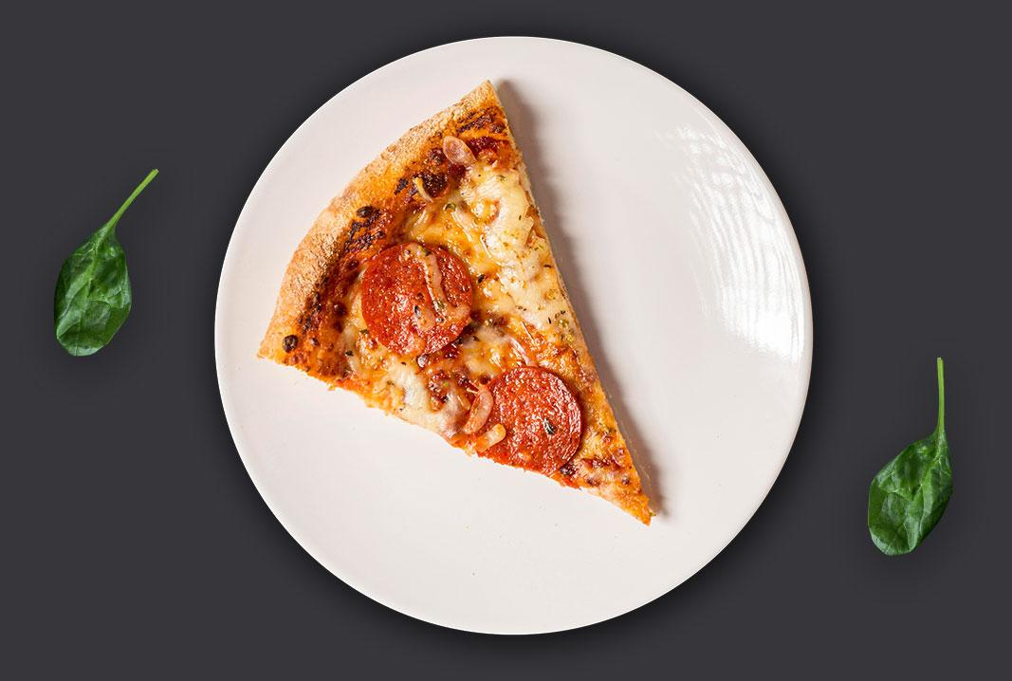

Pizzacoll.com analytics

Slide 2
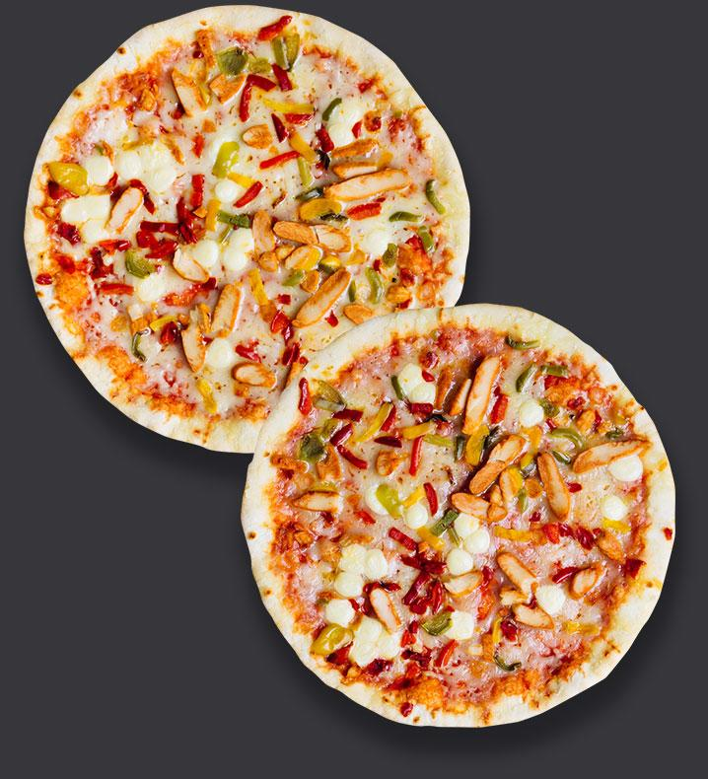
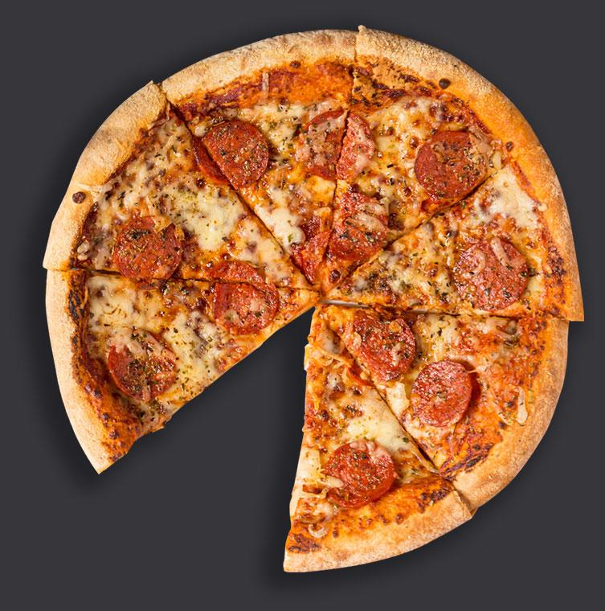
-- Retrieve the total number of orders placed.
SELECT
COUNT(order_id) AS total_orders
FROM
orders;
total_orders
21350

Slide 3
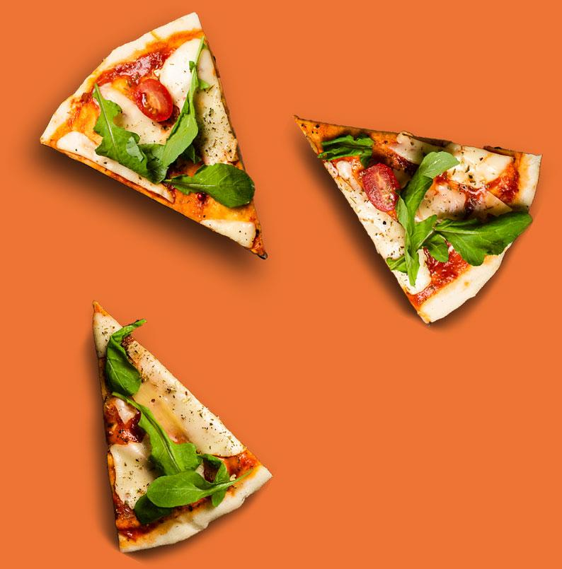
-- the total revenue generated from pizza sales.
SELECT
ROUND(SUM(orders_details.quantity * pizzas.price), 2)
AS total_revenue
FROM
orders_details JOIN pizzas
ON pizzas.pizza_id = orders_details.pizza_id;
total_revenue
817860.05

Slide 4
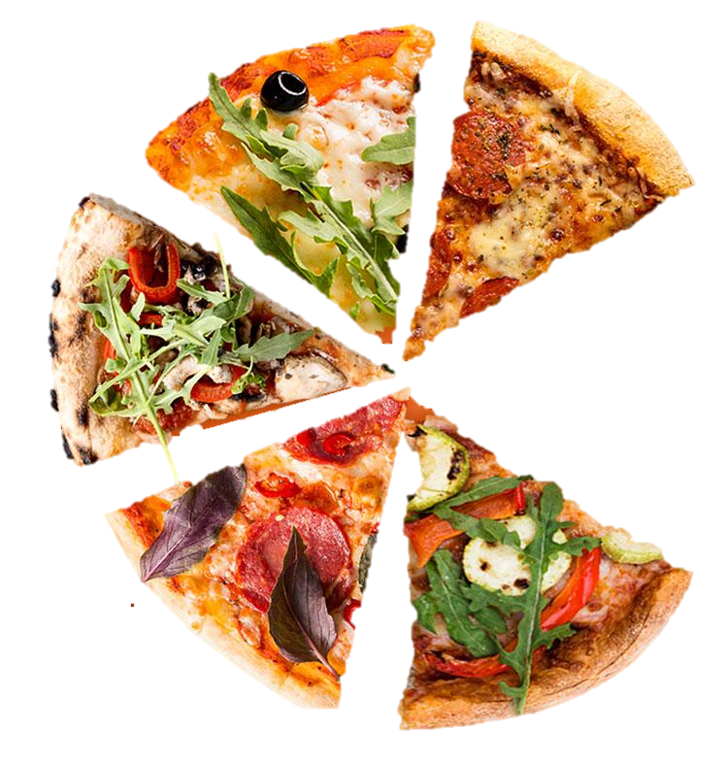
-- the highest-priced pizza.
SELECT
pizza_types.name, pizzas.price
FROM
pizza_types JOIN pizzas
ON pizza_types.pizza_type_idpizzas.pizza_type_id
ORDER BY
pizzas.price DESC
limit 20;
The Greek Pizza 35.95
The Greek Pizza 25.5
The Brie Carrie Pizza 23.65
The Italian Vegetables Pizza 21.00
The Barbecue Chicken Pizza 20.75
The Spinach Supreme Pizza 20.75
The Italian Supreme Pizza 20.75
The California Chicken Pizza 20.75
The Thai Chicken Pizza 20.75
The Spinach Pesto Pizza 20.75
The Chicken Alfredo Pizza 20.75
The Suppressant Pizza 20.75
The Pepper Salami Pizza 20.75
The Chicken Pesto Pizza 20.75
The Prosciutto and Arugula Pizza 20.75
The Spicy Italian Pizza 20.75
The Southwest Chicken Pizza 20.75
The Big Meat Pizza 20.5
The Greek Pizza 20.5
The Classic Deluxe Pizza 20.5

Slide 5

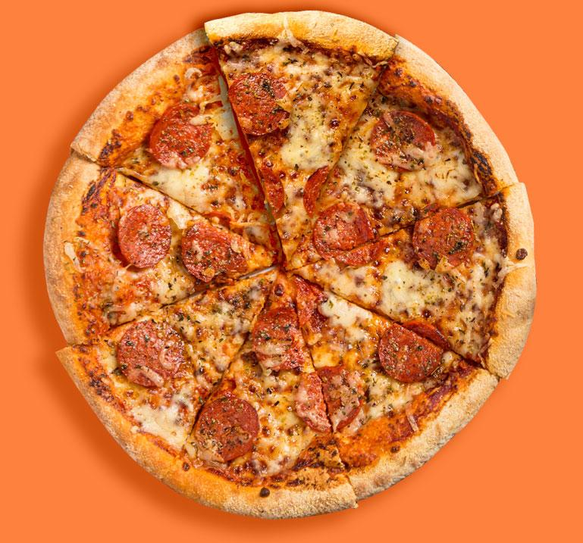
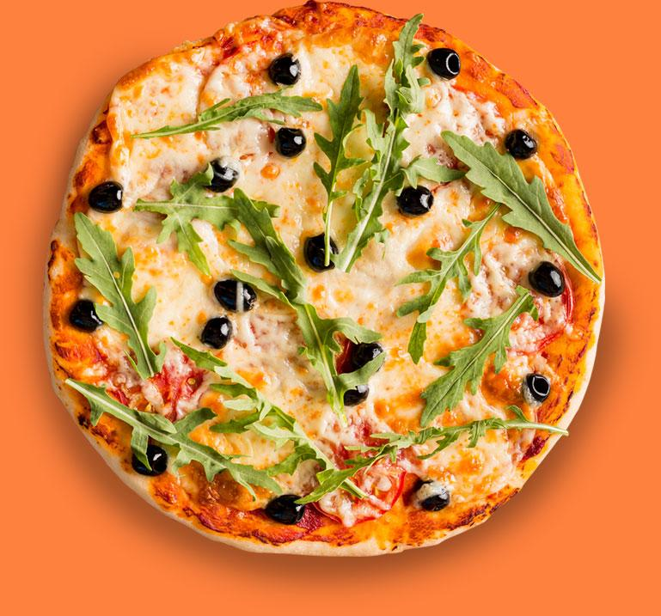
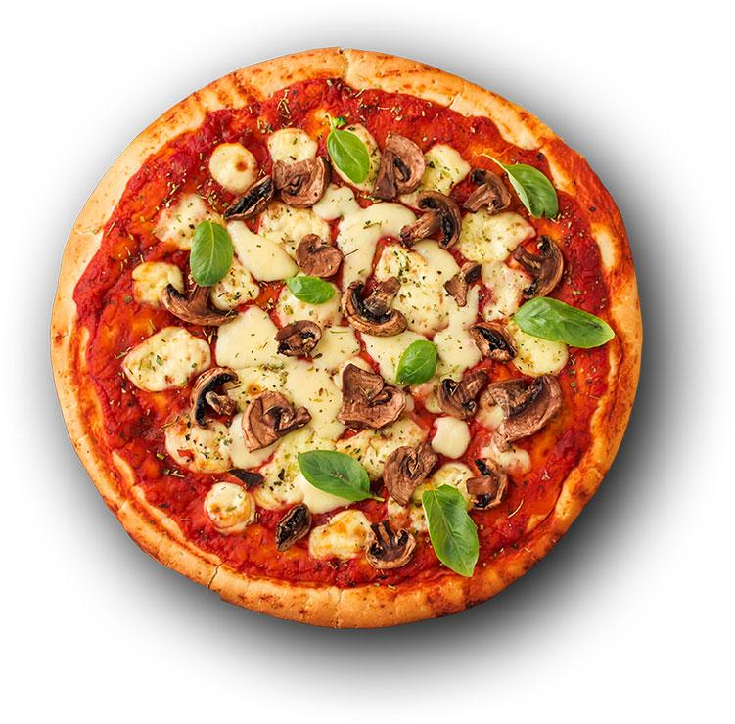

-- the most common pizza size ordered.
SELECT
pizzas.size, COUNT(orders_details.order_details_id)AS order_count
FROM
pizzas JOIN orders_details
ON pizzas.pizza_id = orders_details.pizza_id
GROUP BY
pizzas.size
ORDER BY
order_count DESC;
L 18526
M 15385
S 14137
XL 544
XXL 28
LARGE
MEDIUM
SMALL

Slide 6
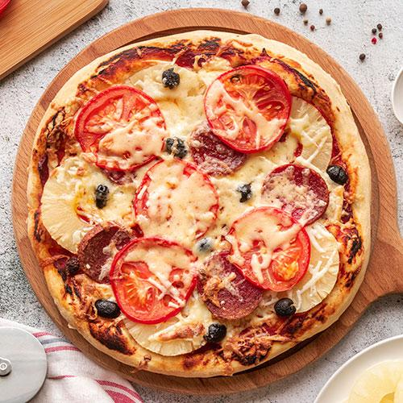
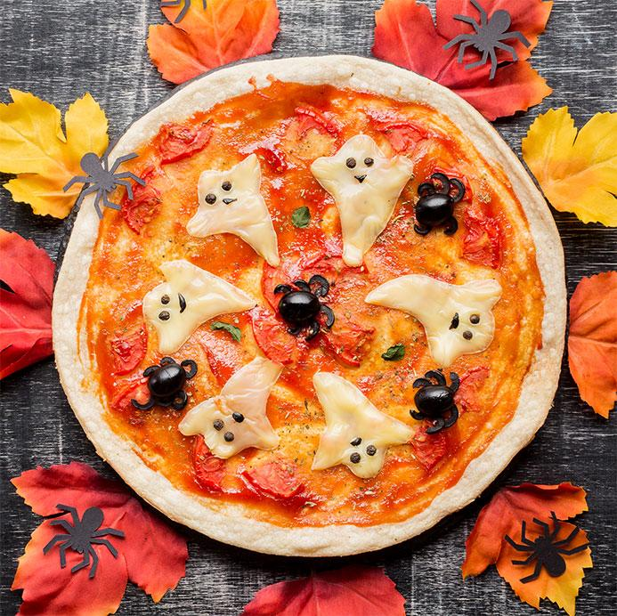
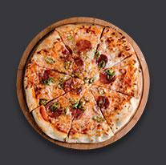
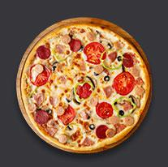
the top 5 most ordered pizza types.
SELECT
pizza_types.name, SUM(orders_details.quantity)order_quantity
FROM
pizza_types JOIN pizzas
ON pizza_types.pizza_type_id = pizzas.pizza_type_id
JOIN orders_details ON orders_details.pizza_id = pizzas.pizza_id
GROUP BY
pizza_types.name
ORDER BY
order_quantity DESC LIMIT 5;
The Classic Deluxe Pizza 2453
The Barbecue Chicken Pizza 2432
The Hawaiian Pizza 2422
The Pepperoni Pizza 2418
The Thai Chicken Pizza 2371

Slide 7
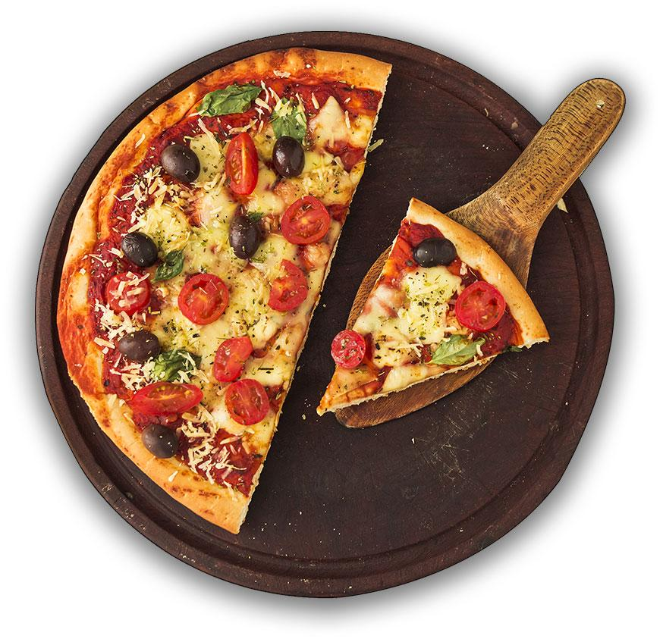

-- Each pizza category by order
SELECT
pizza_types.category, SUM(orders_details.quantity)
AS order_quantity
FROM
pizza_types JOIN pizzas
ON pizza_types.pizza_type_id = pizzas.pizza_type_id
JOIN orders_details
ON orders_details.pizza_id = pizzas.pizza_id
GROUP BY
pizza_types.category
ORDER
BY order_quantity DESC;
category order_quantity
Classic 14888
Supreme 11987
Veggie 11649
Chicken 11050

Slide 8
Distribution of orders by hour of the day.
SELECT
HOUR(orders.order_time) AS hours, SUM(orders_details.quantity) AS quantity
FROM
orders
JOIN orders_details
ON orders.order_id = orders_details.order_id
GROUP BY
hoursORDER BY order_quantity DESC;
Hours quantity
12 6776
13 6413
18 5417
17 5211
19 4406
16 4239
14 3613
20 3534
15 3216
11 2728
21 2545
22 1386
23 68
10 18
9 4

Slide 9
The category-wise distribution of pizzas.
Select
category,count(name) as pizzas_types from
pizza_types
group by
category
category pizzas_types
Chicken 6
Classic 8
Supreme 9
Veggie 9

Slide 10


The average number of pizzas ordered per day.
Select
round(avg(total_orderd),0) as avrage_order_per_day
From
(select orders.order_date as date, sum(orders_details.quantity)
as total_orderd
From
orders
join orders_details on orders.order_id = orders_details.order_id
group by
date)
as order_quantity;
'138'

Slide 11
top 5 most ordered pizza types byb revenue.
SELECT
pizza_types.name AS pizzas,
SUM(orders_details.quantity * pizzas.price) AS revenue
FROM
pizza_types JOIN pizzas
ON pizza_types.pizza_type_id = pizzas.pizza_type_id
JOIN orders_details ON pizzas.pizza_id = orders_details.pizza_id
GROUP BY
pizzas
ORDER BY
revenue DESC LIMIT 5;
Pizzas Revenue
The Thai Chicken Pizza 43434.25
The Barbecue Chicken Pizza 42768
The California Chicken Pizza 41409.5
The Classic Deluxe Pizza 38180.5
The Spicy Italian Pizza 34831.25

Slide 12
percentage contribution of each pizza type to total revenue.
Select
pizza_types.category, round((sum(pizzas.price * orders_details.quantity)
/(select
round(sum(orders_details.quantity * pizzas.price), 2) from orders_details join pizzas
on pizzas.pizza_id = orders_details.pizza_id)
)*100,2)as revenue
From
pizza_types join pizzas
on pizza_types.pizza_type_id = pizzas.pizza_type_id
join orders_details on pizzas.pizza_id = orders_details.pizza_id
group by
pizza_types.category
category revenue_percentage
Classic 26.91
Veggie 23.68
Supreme 25.46
Chicken 23.96

Slide 13
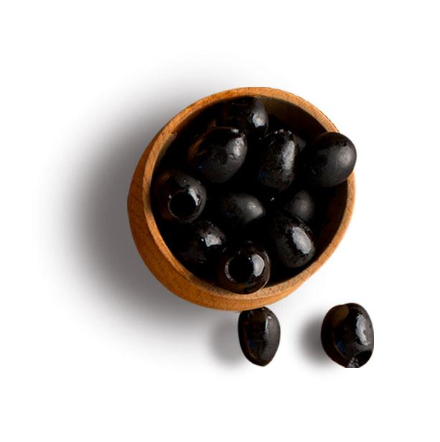
Cumulative revenue generated over time.
Select
order_date,(sum(revenue) over(order by order_date)) as cum_revenuefrom (select
orders.order_date, sum(pizzas.price * orders_details.quantity)
as revenue
from
orders_details join pizzas on orders_details.pizza_id = pizzas.pizza_id
join orders
on orders.order_id = orders_details.order_id
group by orders.order_date)
as sales_per_day;
order_date cum_revenue
2015-12-27 810615.8
2015-12-26 809196.8
2015-12-24 807553.75
2015-12-23 805415.9
2015-12-22 803171.6
2015-12-21 801288.65
2015-12-20 799187.95
2015-12-19 797083.05
2015-12-18 794778.85
2015-12-17 791892.55
2015-12-16 790011.8
2015-12-15 787777
2015-12-14 785389.55
2015-12-13 783216.95
2015-12-12 780971.8
2015-12-11 779011.65
2015-12-10 776377.65
2015-12-09 774392.05
2015-12-08 771820.5
2015-12-07 769964.25
2015-12-06 767549.45
2015-12-05 765199.2
2015-12-04 762571.25
2015-12-03 759692.9
2015-12-02 757449.7
2015-12-01 755235.6

Slide 14
most ordered pizza types based on revenue for each pizza category.
Select
category, name, revenue
From
(select category, name, revenue, rank()
over (partition by category order by revenue desc) as rankingsfrom
(select
pizza_types.category, pizza_types.name, sum(pizzas.price * orders_details.quantity)
as revenue
from
pizza_types join pizzas
on pizza_types.pizza_type_id = pizzas.pizza_type_id
join orders_details on orders_details.pizza_id = pizzas.pizza_id
group by category, name) as t1) as t2
category name revenue
Chicken The Thai Chicken Pizza 43434.25
Chicken The Barbecue Chicken Pizza 42768
Chicken The California Chicken Pizza 41409.5
Classic The Classic Deluxe Pizza 38180.5
Classic The Hawaiian Pizza 32273.25
Classic The Pepperoni Pizza 30161.75
Supreme The Spicy Italian Pizza 34831.25
Supreme The Italian Supreme Pizza 33476.75
Supreme The Sicilian Pizza 30940.5
Veggie The Four Cheese Pizza 32265.70
Veggie The Mexicana Pizza 26780.75
Veggie The Five Cheese Pizza 26066.5

